Slide 1
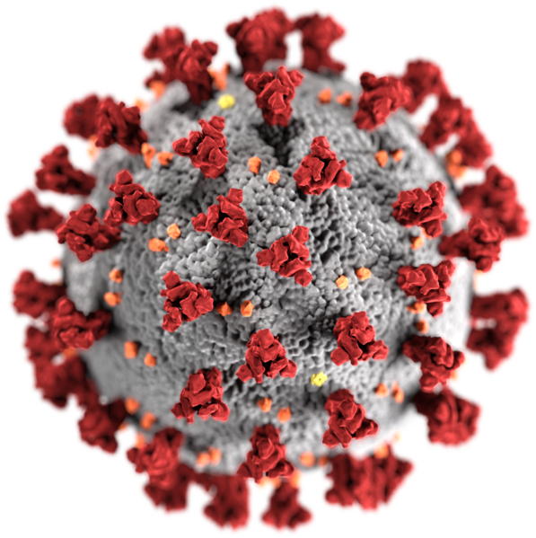
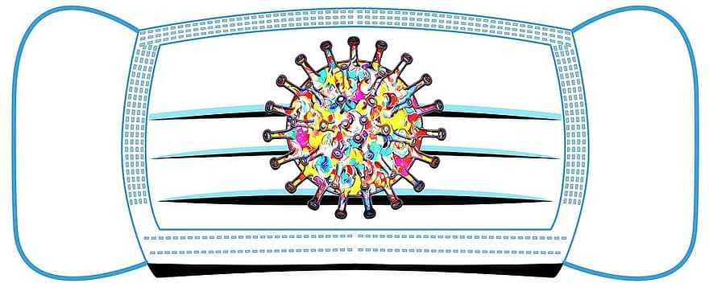
Knowledge, perceptions and attitudes to Covid-19 in
Khayelithsa and Klipfontein sub-districts
Hanne J Haricharan¹, Christine Jansen², Mzwanya Ndibongo³, Nozibile Mdayi² , Tamara Sam⁴, Leslie London¹
¹School of Public Health and Family Medicine, ²Klipfontein Health Forum, ³Khayelitsha Health Forum
INTRODUCTION
A Community-Engaged Research Project between the Health and Human Rights Programme at SOPHFM and Klipfontein and Khayelithsa Health Forums.
Health forums are umbrella bodies for health committees, which are statutory bodies linked to clinics.
Health committees identified a need for more context specific information on Covid-19 to better tailor interventions.
Aims:
a) To understand populations’ knowledge about COVID-19.
b) To assess knowledge of preventative measure and obstacles to these.
c) To understand perceptions and attitudes to COVID-19.
MAIN FINDINGS
Cause of Covid-19:
Risk perception:
Readiness to test:
Willingness to disclose:
Willingness to go to isolation facility:
MAIN FINDINGS
Knowledge of non-pharmaceutical prevention methods:
Obstacles to prevention:
Obstacles identified: access to water, cost of soap, sanitizer and masks. Social distance in taxis was highlighted as a challenge.
Stigma (blame):
TRANSFORMATION
The research was governed by an academic-community partnership with joint decision-making and identification of research question. The research was designed to be relevant for communities.
Health committees are using the research to inform their awareness campaigns.
A DVD capturing experiences of isolation is being produced with the aim of de-mystifying the experience.
A manual on community-engaged research has been produced.
What is Covid?
A disease caused by a virus | 164 (40.0 %)
An infection | 179 (43.7%)
A human-made disease | 40 (9.8 %)
A curse from God | 12 (2.9 %)
A lie | 23 (5.5 %)
Don’t know | 14 (3.4%)
Did not answer question | 3 (0.7 %)
 | Is it necessary to wash hands or use sanitiser? | Is it necessary to wear a mask in public? | Is it necessary to practice social distancing?
Yes | 405 (98.8%) | 405 (98.2%) | 392 (95.6%)
No | 2 (0.5%) | 4 (1.0%) | 7 (1.7%)
Did not answer | 3 (0.7%) | 1 (0.2%) | 11 (2.7%)
 | Do you think you are at risk of getting Covid-19?
Yes | 300 (73.2%)
No | 93 (22.7%)
Did not answer | 17 (4.2%)
 | Do you experience obstacles to hand-washing? | Do you experience obstacles to wearing a mask? | Do you experience obstacles to practicing social distance?
Yes | 138 (33.7%) | 201 (49.0%) | 392 (95.6%)
No | 237 (57.8%) | 196 (47.8%) | 7 (1.7%)
Did not answer | 25 (6.1%) | 13 (3.2%) | 11 (2.7%)
SOCIAL Responsiveness
The research contributes to UCT’s goal of being a socially responsive university.
It also contributes to Sustainable Development Goal 3 and 4 by promoting health, wellbeing and life-long learning opportunities for people often excluded from formal learning opportunities.
 | Will you test if symptomatic, over 55, have illnesses that put you at risk or have had contact with someone with Covid-19?
Yes | 221 (53.9%)
No | 43 (10.5%)
Did not answer | 146 (35.6%)
This Photo by Unknown Author is licensed under CC BY-SA-NC
methods
Data collection: a survey containing closed and open-ended questions with 410 residents in Klipfontein and Khayelitsha sub-districts.
Data analysis: descriptive statistics and thematic content analysis.
 | Would you disclose you had Covid-19 if you tested positive?
Yes | 366 (89.3%)
No | 30 (7.3%)
Did not answer | 14 (2.4%)
ACKNOWLEDGEMENTS
We acknowledge the health committee members who collected and captured the data and the NRF, which funded the study through a Community
Engagement Grant.
FURTHER INFORMATION:
Hanne.Haricharan@uct.ac.za
 | People who get Covid-19 have themselves to blame
Strongly agree | 3 (0.7%)
Agree | 19 (4.6%)
Neither agree/disagree | 21 (5.1%)
Disagree | 267 (65.1%)
Strongly disagree | 51 (12.4%)
Did not answer | 47 (11.5%)
 | Would you go to an isolation facility if this was suggested?
Yes | 295 (72.0%)
No | 107 (26.1%)
Did not answer | 8 (2.0%)

