Slide 1
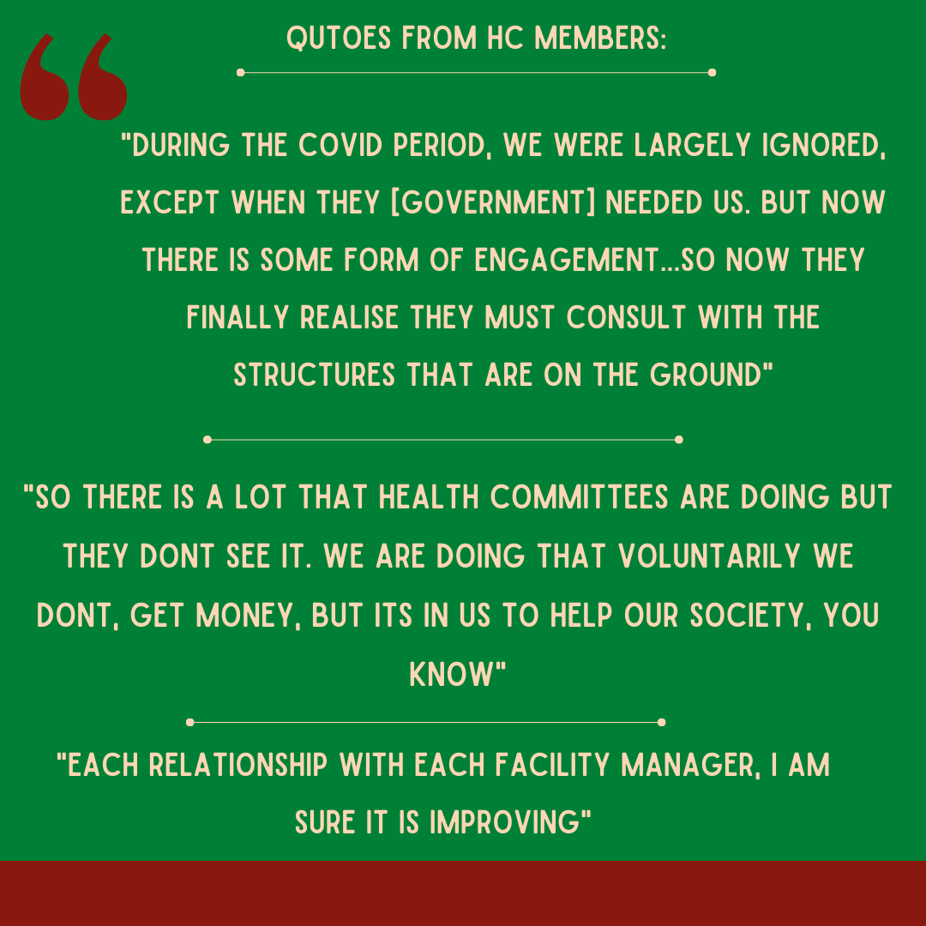
“The Lockdown – Community Perspectives”: Facilitated Film Viewings to Foster Community Engagement & Promote Community-based Solutions to Covid-19
Natasha Kannemeyer¹, Hanne Haricharan ², Christopher J Colvin ³
¹MPH Candidate, Division of Social and Behavioural Sciences, UCT, Cape Town, South Africa, ²University of Cape Town, Cape Town, South Africa, ³University of Cape Town, Cape Town, South Africa
INTRODUCTION
Community engagement is central to the delivery of primary health care.^{1,2}
Engaging with communities addresses issues of trust and develops relationships which improve intervention adherence and thus helps reduce the spread of infectious diseases for example Ebola and Covid-19.³
Health Committees (HC) are community structures that facilitate and allow community members to be part of health governance.^{1,2}
Engagement between government, health providers and HCs is lacking.² HCs feel unrecognised and undervalued and are often underutilised.^{1,2}
Covid-19 was an opportunity to involve HCs in the response.⁴
FINDINGS
HC members resonated with the content of the film and the film viewings highlighted the importance of talking and sharing experiences of Covid-19.
Covid-19 impacted the quality and level of engagement between HCs, government and health professionals.
New lines of communication emerged via the inclusion of HC members on WhatsApp communication groups with clinic facility managers and through inclusion in weekly health professional Zoom meetings.
Relationships between HC members, facility managers, facility staff (nurses, security staff) were improved as members spoke about being greeted, called by their names and feeling recognised.
Once the rollout of Covid-19 vaccines, HC members felt that they were recognised in a new way and asked to contribute and assist in the response to Covid-19. HC members were asked to facilitate vaccine training and workshops in several communities in Cape Town, South Africa.
Materials and methods
A qualitative study with two HCs from the Klipfontein sub-district using film viewings and focus group discussions. The film: The Lockdown – Community Perspectives, captures people’s experiences of lockdown from eight different communities in Cape Town, South Africa. The film was a documentary part of an MPH practicum completed by this student researcher last year. The film was shown to explore if and how the film fosters community engagement and promotes community-based solutions in response to the Covid-19 pandemic.
Three phases:
Film viewings followed by FGDs.
Observations of HC meetings, vaccine training workshops, health forum meetings.
Follow up FGDs exploring the impact of the film viewings on discussion and engagement (currently underway).
TRANSFORMATION
HC members expressed reluctance to be part of research in general due to lack of feedback from previous researchers. To address this, I attended HC meetings, had informal conversations with HC members, and provided feedback and updates to HC members throughout the research process to engage with and include members and to build relationships.
SOCIAL Responsiveness
This research is socially relevant as it focuses on community engagement. Community recognition, inclusion, engagement and research transparency is key to infectious disease outbreak responses (e.g. Ebola; Covid-19) and to the implementation of interventions.³
CONCLUSIONS AND WAY FORWARD
Access to data to attend Zoom meetings and participate in the WhatsApp groups should be supported by government.
The way forward should consider how engagement and participation with HCs will be maintained and sustained post Covid-19.
Upon completion of data analysis and write-up, a research dissemination and discussion session will be held in Dec 2021. This will be an opportunity for HC members, community members and stakeholders to interact with the findings and discuss ways to improve and sustain HC engagement.
ACKNOWLEDGEMENTS AND FUNDING SOURCE(S). Supervisors: Assoc Prof Chris Colvin, Dr Hanne Haricharan; Funding: National Research Foundation (NRF)
References
Haricharan H, et al. The role of community participation in primary health care: practices of South African health committees. Prim Health Care Res Dev. 2021;22(e31):1-10.. URL: https://www.cambridge.org/core/journals/primary-health-care-research-and-development/article/role-of-community-participation-in-primary-health-care-practices-of-south-african-health-committees/8BA5670B915E7A0EBFC1ECD564D8A708
Zwama G, et al. Rights-based training enhancing engagement of health providers with communities, Cape Metropole, South Africa. Front Sociol. 2019;4:35. URL: https://www.frontiersin.org/articles/10.3389/fsoc.2019.00035/pdf
Anoko JN et al. Community engagement fo successful Covid-19 pandemic response: 10 lessons from Ebola outbreak responses in Africa. BMJ Global Health. 2020;4:e003121. URL:https://gh.bmj.com/content/bmjgh/4/Suppl_7/e003121.full.pdf https://gh.bmj.com/content/bmjgh/4/Suppl_7/e003121.full.pdf
People’s Health Movement, South Africa. Letter to Western Cape MEC of health Hon French Mbombo: recognition of health committees during Covid-19. 2020. URL: https://www.phm-sa.org/letter-to-western-cape-mec-of-health-hon-french-mbombo-recognition-of-health-committees-during-covid-19/
CONTACT DETAILS FOR FURTHER INFORMATION Natasha Kannemeyer
Email: natasha.kannemeyer@uct.ac.za

