Slide 1
Communities Doing it for themselves

Slide 2
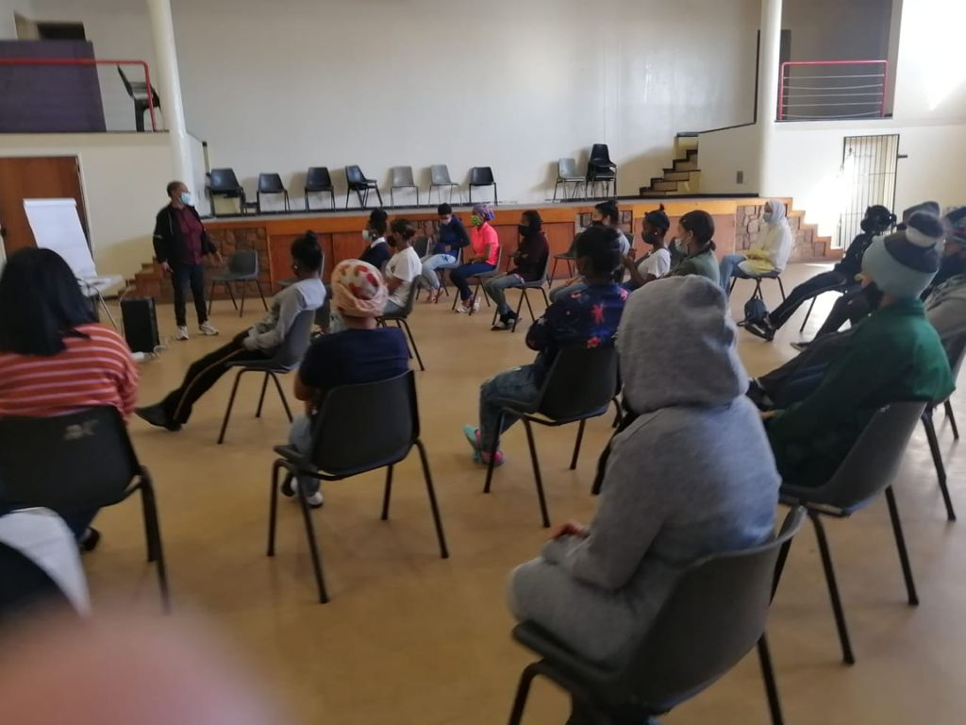
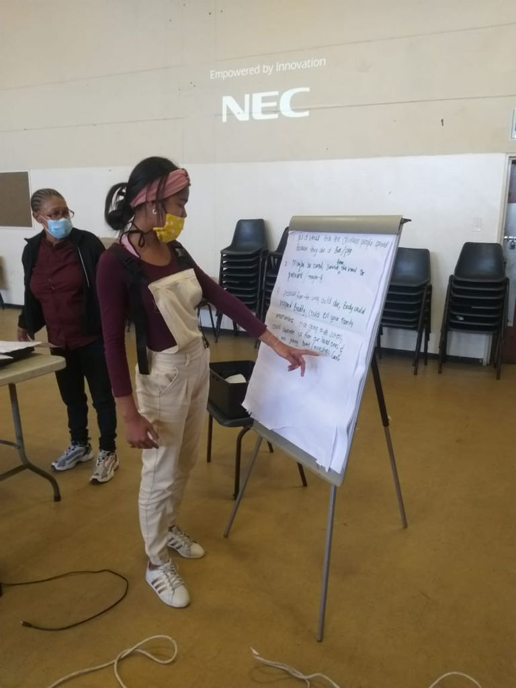
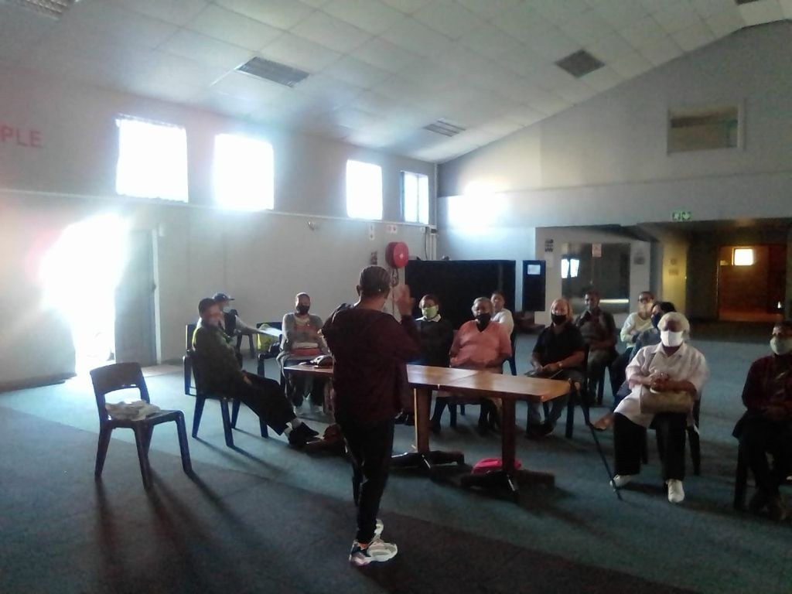
What have we done
1.Raising awareness
We started by empowering ourselves first through strenghthening health commitees through training
Training health committee members with confidence and skill to be able to facilitate
Training topics: included Covid 19 What it is ?
What the vaccine is ? We had workshops with seniors elderly, youth groups, churches, school, home visits to individual homes , speaking to family members, street commitees, with neighbourhood watches
We had training workshops with CHW and in this way we could explain the local issues that affected us in the pandemic.

Slide 3
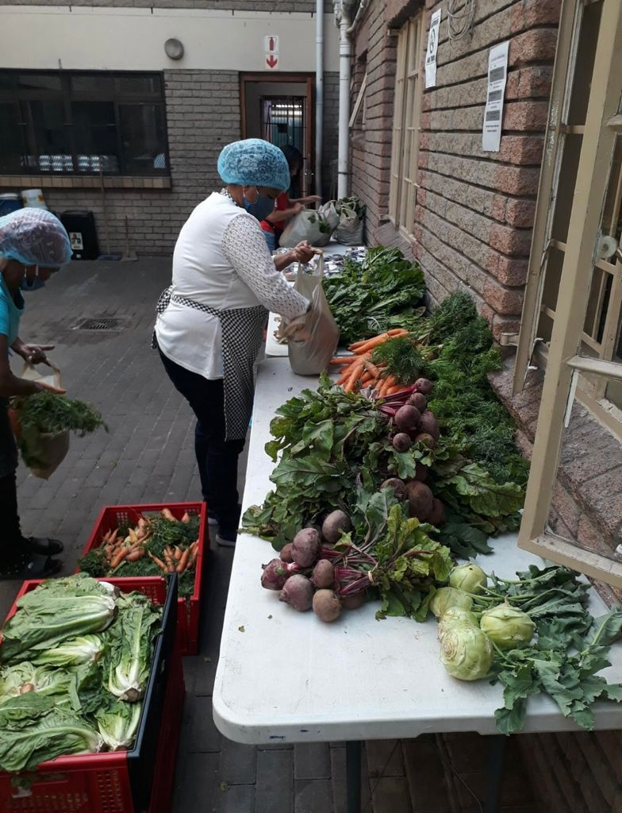
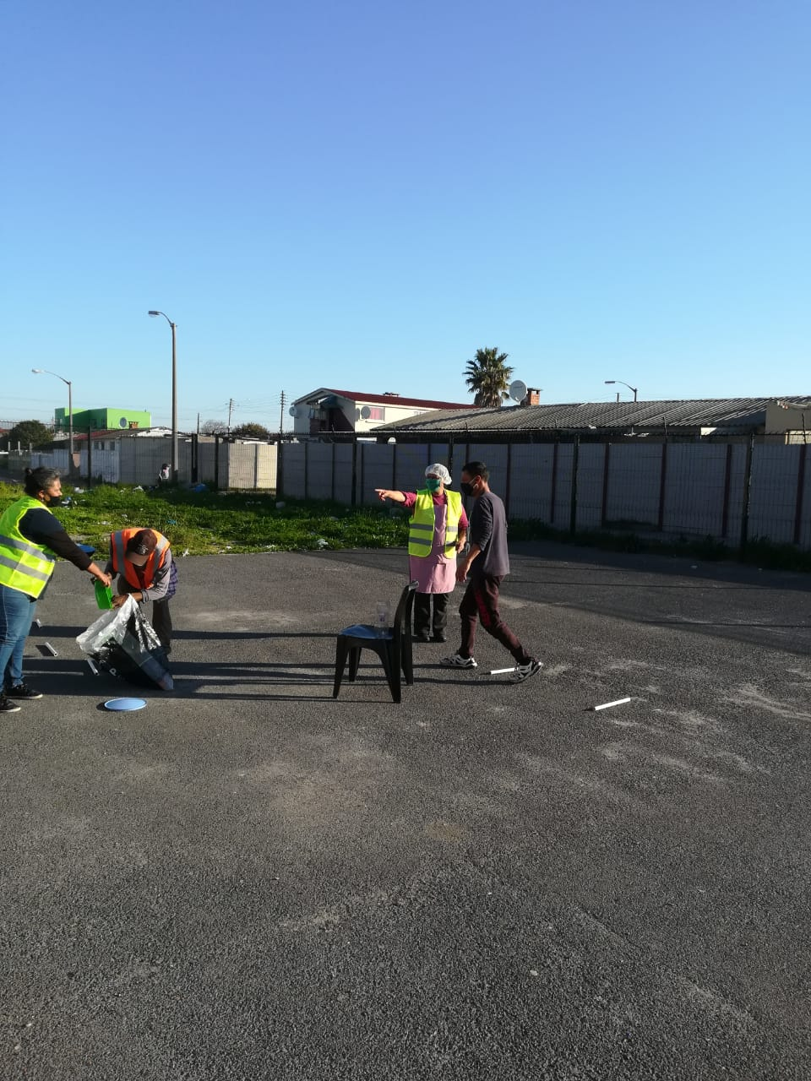
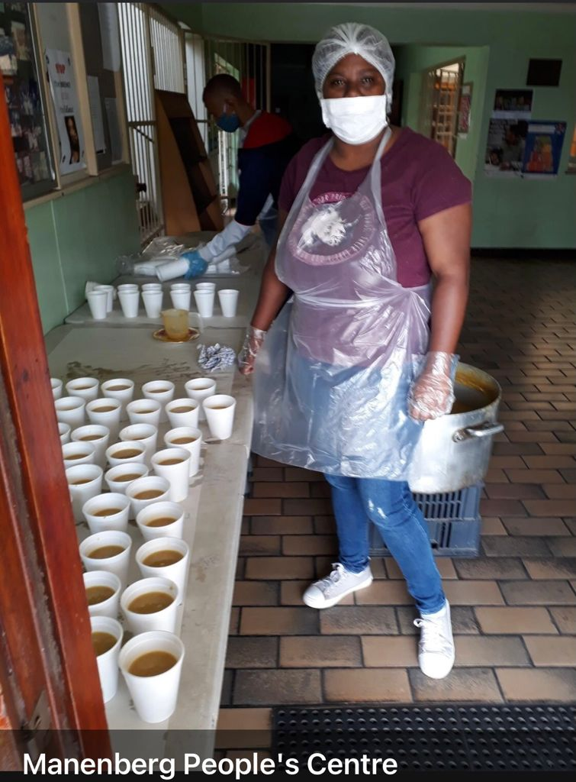
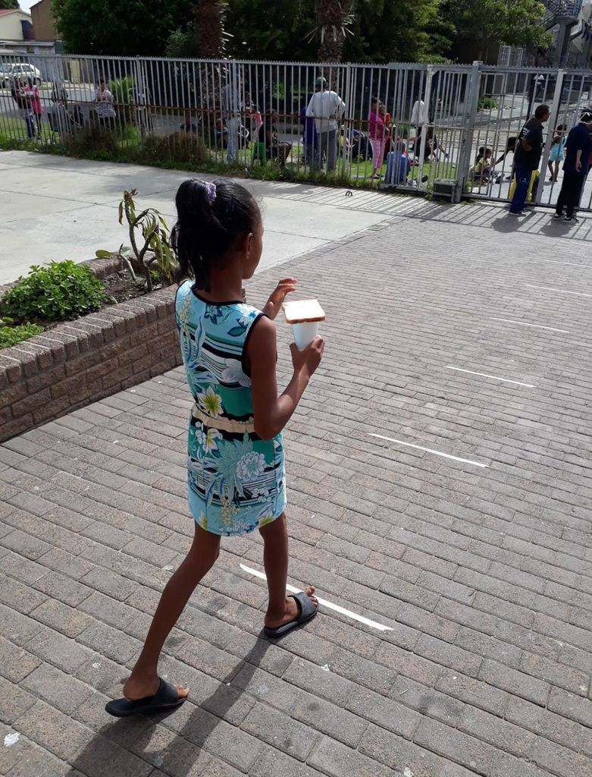
2. Relief to communities
Some members started soup kitchens close to peoples homes, existing kitchens like MPC were strenghthened with funds from the council
In different communities, members have been involved in distributing of food, masks, sanitising pack.
Barrier due to funds running out lots of kitchens had to close down . Some bigger food conduits and bigger NPO’s still continue to help smaller kitchens and continue to have links and partnerships

Slide 4
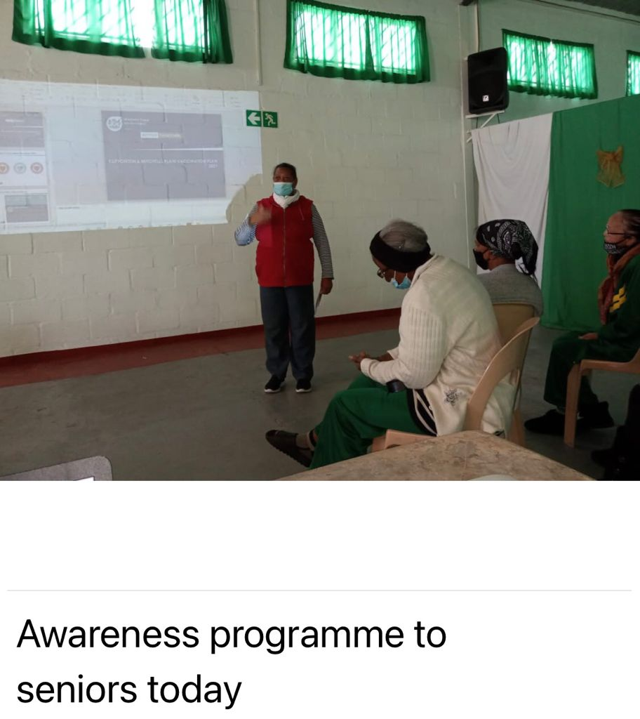
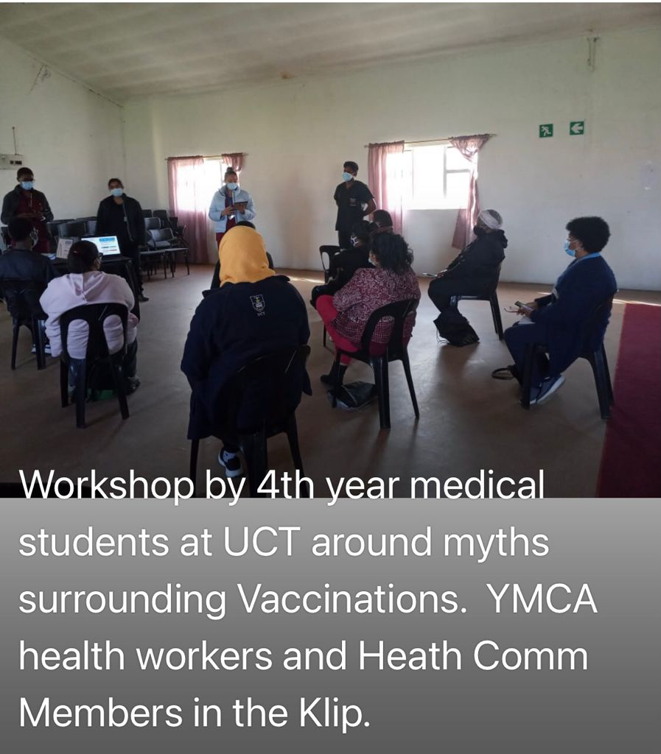
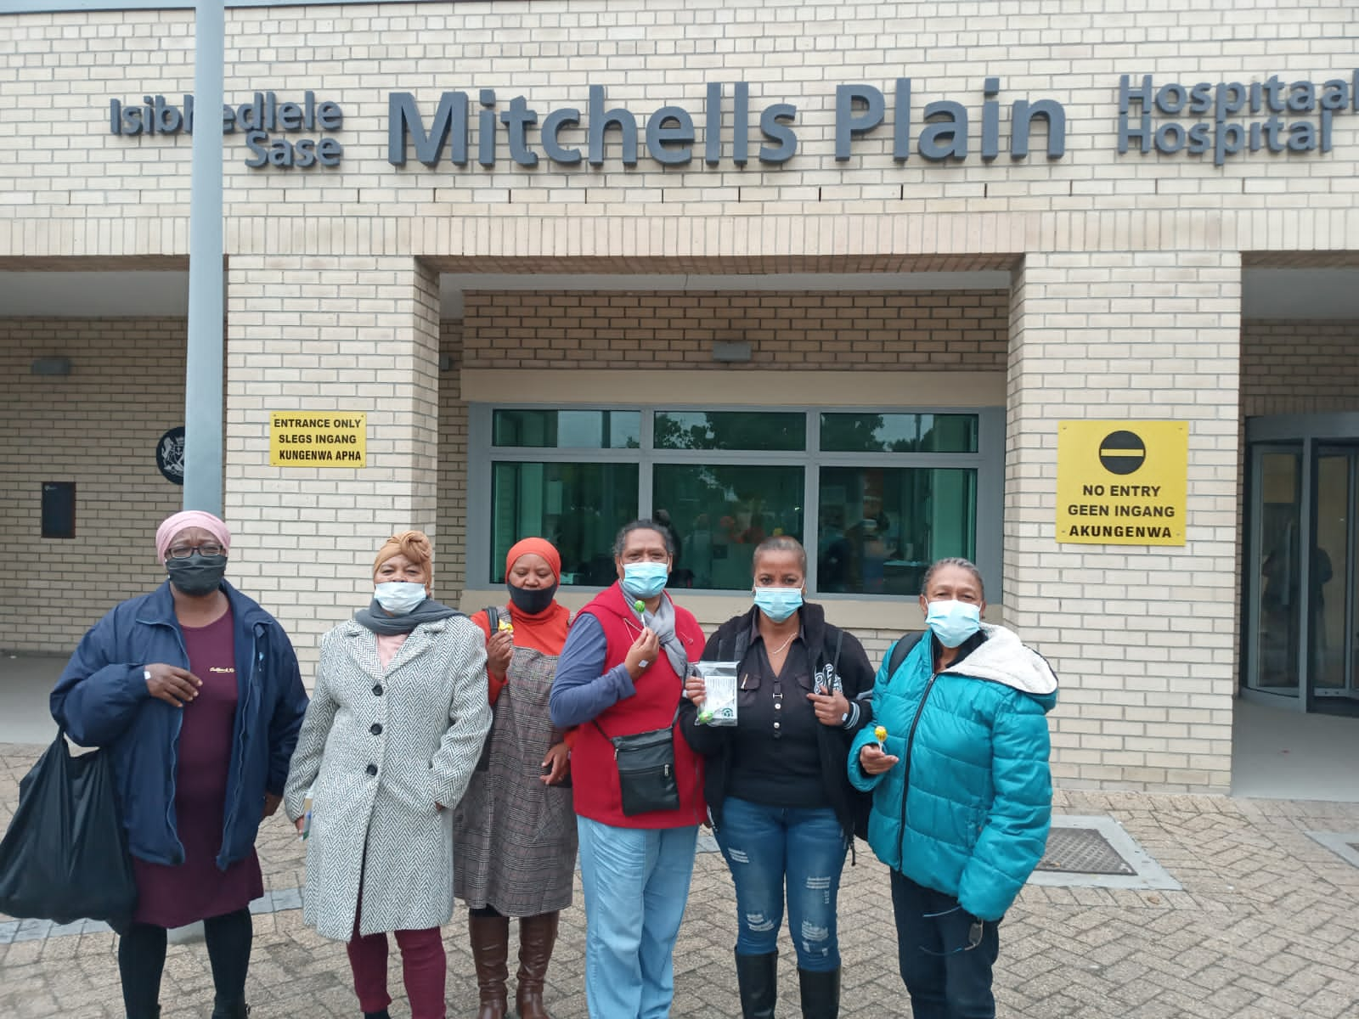
3.Information on vaccine and other vaccine
efforts
Talks with seniors , with youth groups , schools, churches
Pamphlet distribution
Designed pamphlet
Trained volunteers to be on vaccination site (Hanover park)

Slide 5
4. Research
Completed community research training
Implemented and used skills to conduct independent research by doing a telephonic survey “Understanding the experiences and responses of residents in Klipfontein sub – districts to the Covid 19 pandemic.”

Slide 6
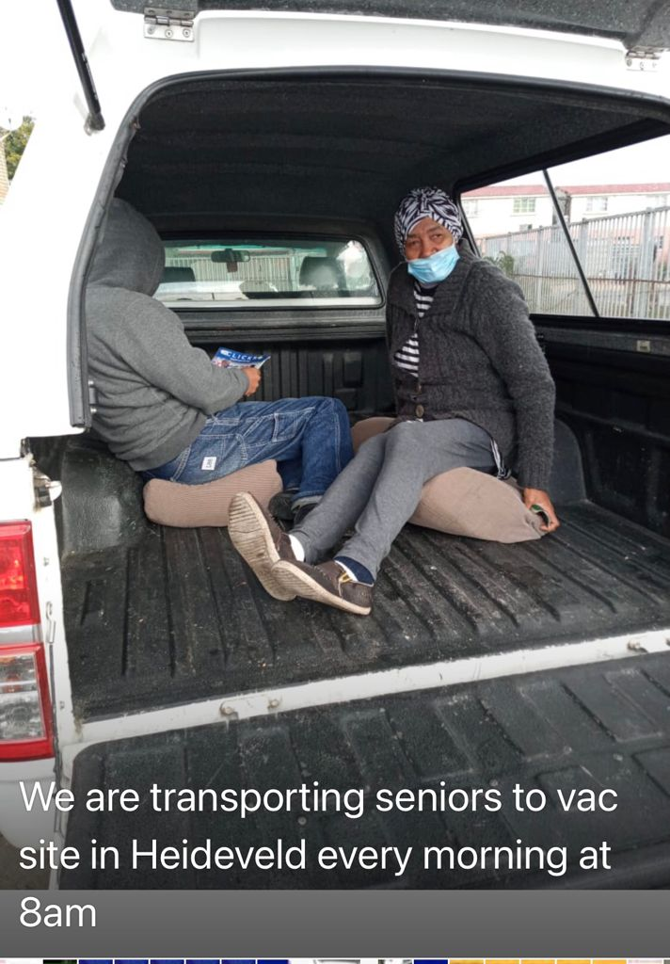
5.Monitoring and advocacy and other interventions
The health committee engaged with the Department of health around the vaccine roll out via a whats app group
We recruited individuals and helped people to sign up for the vaccine
Manenberg people centre mobilised by the health committee used their vehicle to transport people to the vaccine sites
Doctors and nurses were escorted by Neighbourhood watches to the homes of frailcare patients to vaccinate local patients.
Health committee members monitored local old age homes and raised written complaints where they felt that the lives of the elderly were compromised due to lack of health and safety protocol relating to the pandemic .
Health committee members used media platforms and official pathways to raise complaints.

Slide 7
What have we learned
Information sharing with one another was important (Networking)
Due to the training we had we could tackle challenges in the community better and deal with disinformation and fake news.
We could inform our communities around C19 protocols and the symptoms of Covid
The training made us aware of how we as health committees should conduct ourselves to impact communities or to impact different platforms.
The training has impacted the attitudes and awareness of individual health committee members and based on this all members are vaccinated and have positively impacted or spread the message of vaccinationto the community
Through the training on vaccination we could confidently spread the correct message of vaccination in a positive and respectful way because we were confident of our knowledge and we could discriminate between fake news and misinformation.
A lot of health committee members were force to attend online meetings and whats app and this improved their skill and confidence with using technology to impact their community and to engage with stakeholders and officials

Slide 8
What the health systems /health services should do ?
Type of support that we need
The department of health must acknowledge the work of health committees because some members are nominated according to the health act
By ignoring community participation and the health committee voice officials are flaunting the health ACT
Officials often do not come out to communities because of perceived dangers etc but health communities live within the community and directly immersed in what is going on locally
Communication barriers existed between DOH and Health committees and often there was a one way , TOP DOWN communication .
Health committees continued with the work in conjunction with local communities and often there was no support from the Official health sources .
Communities had to source their own means to educate themselves with PHM as this organisation saw us as equal partners .
NACOSA informed the health committee that the Department of health should work with health committees with that workshop members wrote an email to the Klipfontein Mitchells Plain health Substructure to force them to work with us .
Only after that there was more equal communication but this is not entirely entrenched yet.
99% of Health committee members are volunteers and unemployed so the distribution of power rests with the Department of health who is not leveraging that power to enable health commitees to do for themselves maximally.
Health committees often could not participate in zoom meetings , ms teams meetings and whats app .
Health committees had to rely on local NGO’s for infra structural supportand acess to email . Internet etc.
The language often used in zoom meetings were not understandable and empowering.
The health commitees forged links with the local municipality health services ward councillors and subcouncils.
As Communities we feel that their should be stronger links between the DOH and the local Municipal healthservices.

Slide 9
Thank you

