Slide 1
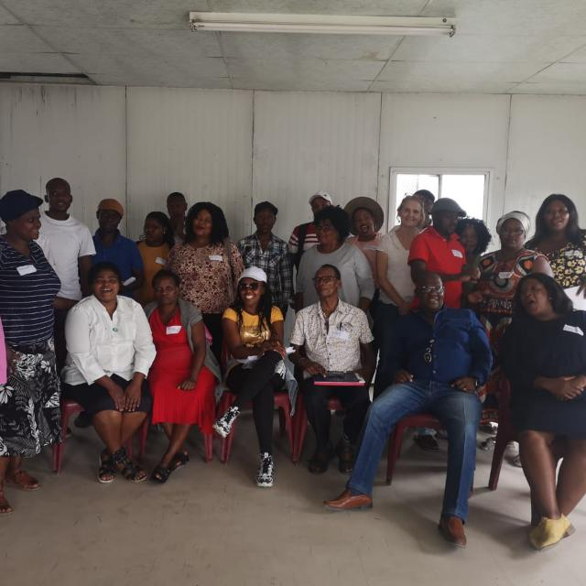
Khayelitsha health forum
Presentation
Covid-19 Communities doing it for themselves

Slide 2
What we have done
We have done research on Covid-19 to find out how the pandemic has affected our lives and get to hear different views on how people have managed to cope under the lockdown and losing their loved ones due to covid-19 and how it has exposed the failed health system
We have selected 15 volunteers who was trained on covid-19 and vaccine to do awareness and education within the community and through collaboration efforts those volunteers are now employed as temporal workers under MSF.
The khayelitsha health forum executive leads a covid-19 steering committee which is made out of the Department of health and all the key role layers within health and we are part of the Provincial steering committees playing the role of advising the Western cape department of health

Slide 3
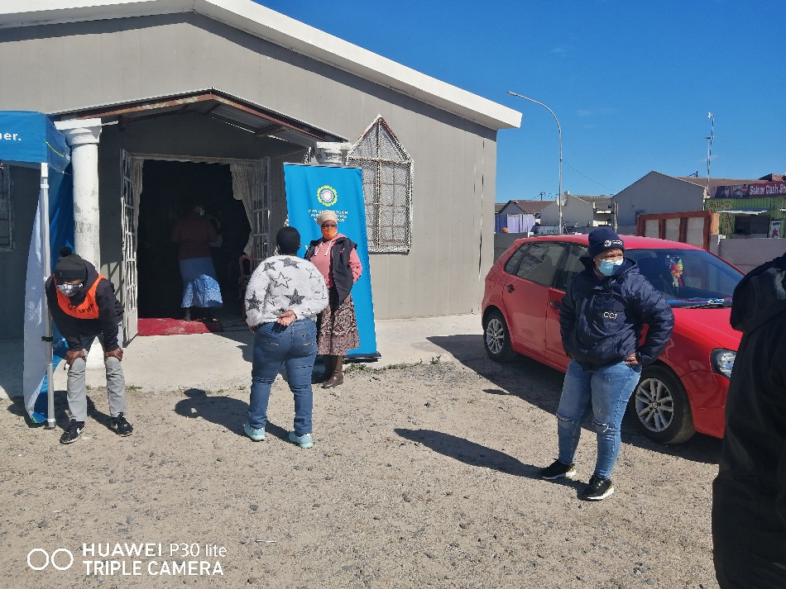
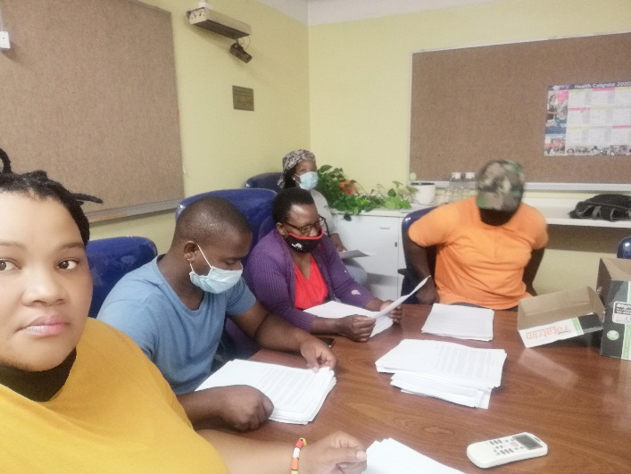
Pictures of volunteers doing community awareness and education at the vaccination site

Slide 4
What we have learned
We have learned that sitting and waiting for the department to involve communities would delay and the best we did was to initiate space where we play our part as health activist and lobby the department od health to join forces. The efforts we made created an opportunity to have and understand covid-19 and the plan in delivering health care services playing the part of making the department of health accountable and share its plans on making sure that the interest of the community are meant when it comes to health service delivery.
We have learned that under pandemic government should involve stakeholders in the in all processes because each stakeholder plays a vital role and it should be transparent all the time
The government is quite and not open enough to share with its members of the country as too why we have been receiving vaccine in batches that and that countries with money are calling the shorts in buying vaccine in huge numbers , the panted law and companies manufacturing the vaccine being selfish .

Slide 5
What the health services/health services should do
Involve all stakeholders in order to deliver an effective and clear program on how best to deal with the Pandemic
Create a system that is transparent so to avoid corruption
Having a Monitoring system that gets to be monitored every month so to understand what works and what doesn’t work
Avail resources so for key role players to be able to work and delivered

Slide 6
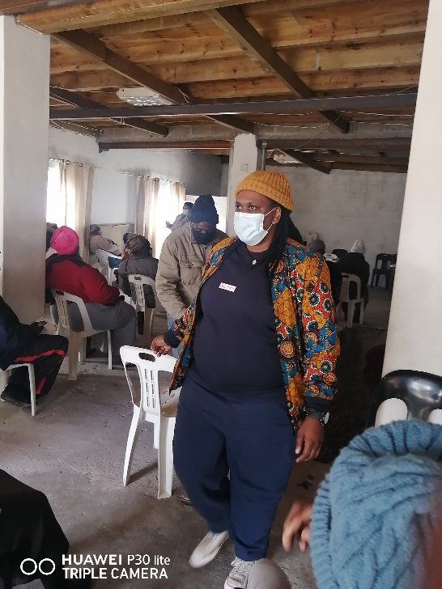
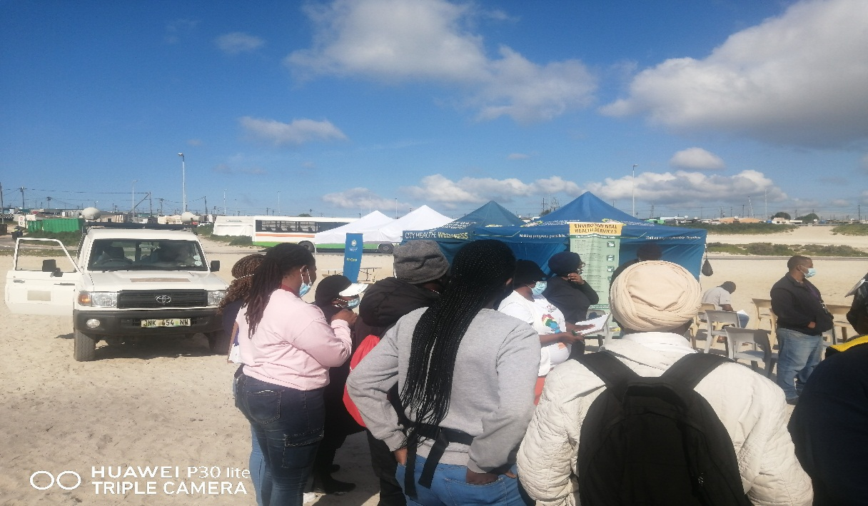
Pictures of our health committees working

