Slide 1
Experiences from Gugulethu
Nowhi Mdayi, Klipfontein Health Forum

Slide 2
Guglethu in the Time of Covid
Gugulethu and surroundings found it very difficult when Coved-19 came. As we know our health system was collapsing before Covid in term access to health care services.
Health activists had to intervene when people were dying.

Slide 3
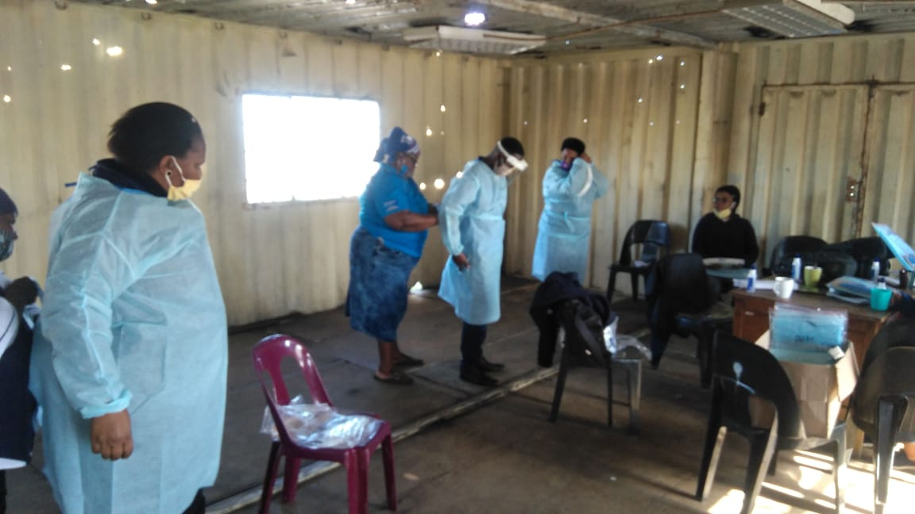

Slide 4
What DID WE DO?
Provided sanitisers and masks: There were complaints about not having sanitizers and masks, and that hospitals would rather send people home if they did not have a mask.
The health committees spent time at clinics to make sure people had masks and sanitizers.
Health awareness: The health forum educated communities about what is Covid-19.

Slide 5
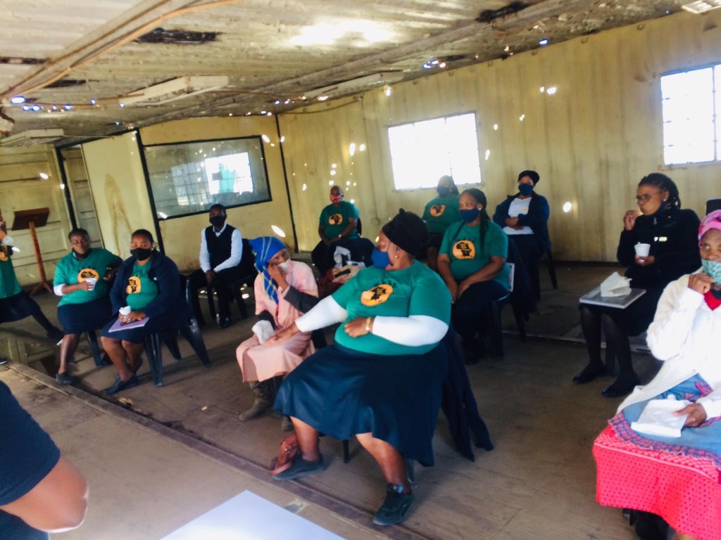
Training of volunteers.

Slide 6
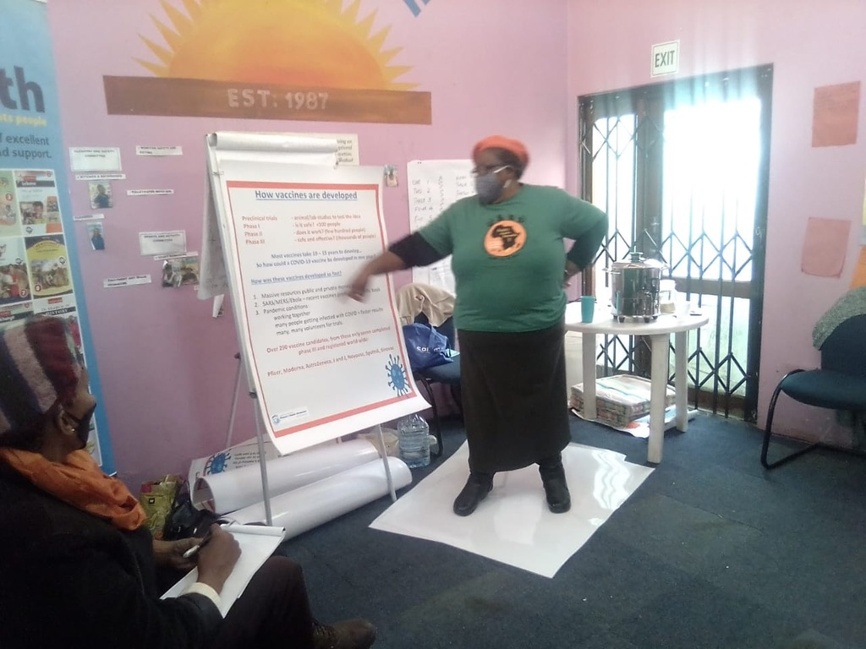
Vaccines: Now we are busy doing vaccine training as people fear taking the vaccine because of all the false information on social media.
.

Slide 7
What we have learned
To organize ourselves as health forums and form partnership with other organizations like PHM and UCT.
Strengthen partnership so that they can help us with PPEs that the Department of Health never provides to us.
Health Department does not respond to community need: Health committees are at the front line without resources. We requested PHM to help our CCWc with PPEs as they are the ones at most risk of Corona as they must deliver medication to households.

Slide 8
What We Have Learned
Research: What helped us more is the research program that we did when our health activists interviewed some community members to get their views and knowledge about Covid-19.
This Corona virus made our people to have love for each other as much as it brought trauma, and anxiety. But our people remained focused and provided for each other. They made soup kitchens as children were at home and food security was a demand.

Slide 9
What should the Health System Do?
As the MEC visited Gugulethu she must not end up outside the clinic she must get inside and do monitoring, because those people that she deployed lack capacity to do monitoring and evaluation.
I don't what to talk about PPEs thing that they know they must provide.
The Department should also educate communities, but they don’t

Slide 10
