Slide 1
Health committees in policies and practice
Health Committees: Policy and Practice
Hanne Jensen Haricharan
School of Public Health, UCT
PHASA 2019

Slide 2
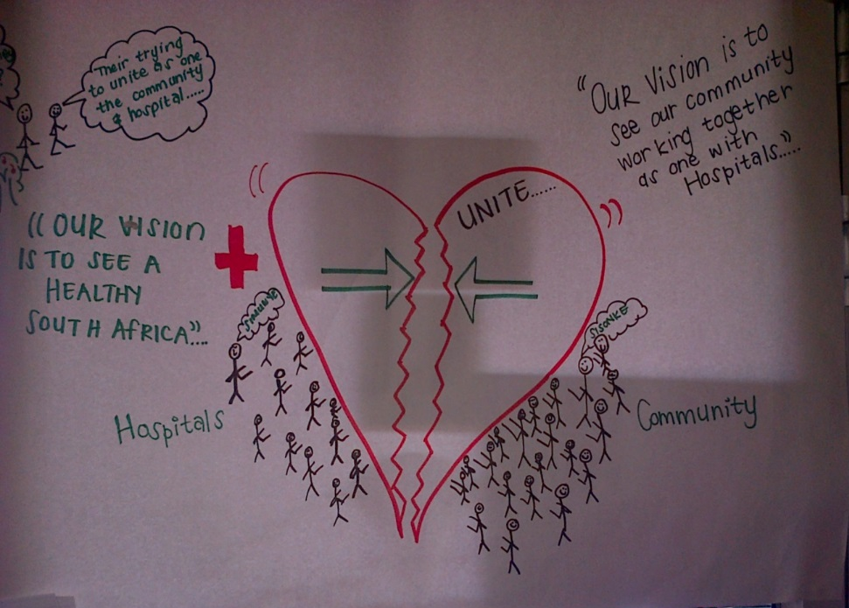
Overview of session
1. Overview of frameworks, policies and research.
2. DVDs on health committees.
3. Experiences from Khayelitsha and Klipfontein.
4. Group discussions.
5. Feedback and plenary.

Slide 3
Primary health care and participation
Alma-Ata (1978) articulated the concept of community participation in PHC:
“The people have the right and duty to participate individually and collectively in the planning and implementation of their health care.”
And develops through appropriate education the ability of communities to participate.”
Astana Declaration 2018.
Notes:
Now I want to talk

Slide 4
Participation and Human Rights
Participation is central to all other rights - health.
General Comment 14:
Participation = decision-making in
setting priorities, planning, implementing and evaluating.
Political decisions.
National public health strategy.
State responsibility to put in place participatory mechanisms.
Participation is a fundamental human right and central to PHC.
Notes:
Expert Interpretation of the Right to Health.

Slide 5
Timeline of health committee policies
National Health Act
First Provincial Policies
Western Cape Health Facility Boards and Committee Act
National Health Insurance Bill
1997 2003 2008 2009 2013 2016 2018 2019
White Paper on the Transformation of the Health System
Western Cape Draft Policy on Health Committees
National Policy on Health Governance Structures
Ideal Clinic

Slide 6
National policies
 | White Paper | NHA | National Draft Policy Paper | Ideal Clinic
Roles | Planning and provision of health services Accountability | Left to provincial policies | Governance and accountability: Planning, prioritization, advice, support, staff issues, advocacy | Identify community needs, compliant management
Formation | Elected | N/A | N/A (appointments?) | Appointments
Composition | N/A | FM, Ward councillor, community members | N/A | N/A
Support | Education | N/A | Training | N/A
Notes:
Not included NHI because it does not say anything really, refers to a policy paper probably the National Draft Policy

Slide 7
Provincial policies
Province | Policy exists | Form | Year
Eastern Cape | Yes | Policy | 2009
KwaZulu-Natal | Yes | In Provincial Health Act | 2009
Free State | Yes | In Provincial Health Act | 2009
Mpumalanga | Yes | Guidelines | 2009
Gauteng | Yes | Draft guidelines | 2009
Western Cape | Yes | Act | 2016
Limpopo | Yes | Yes | 2009
NorthWest | Yes | Policy | 2014
Northern Cape | Yes | Policy | 2013
Notes:
Go through quickly

Slide 8
Roles of health committees
Role | Explanation | Provinces
GOVERNANCE | Policy, strategy, planning, identify health needs | All besides W Cape
OVERSIGHT/ACCOUNTABILITY | Monitoring, complaints management | All besides W Cape
NETWORKING | Strengthen ties with communities and stakeholders | All
ADVOCACY | ‘Represent facility’, advocate for using services | Eastern Cape, Mpumalanga
FUNDRAISING | Raise funds for facility, HCs, PHC activities | Mpumalanga, Gauteng, Cape
SOCIAL MOBILISATION | Community involved in health | Eastern Cape
SUPPORT FOR FACILITY |  | Gauteng
SOCIAL DETERMINANTS OF HEALTH
Notes:
Policies vary greatly in length, content and detail. Only one provincial policy talk about hc’s as governance structure: Northern Cape.

Slide 9
Formation, Composition and Support in Provincial Policies
Formation process | Provinces
Appointed by MEC | Free state, Mpumalanga, Kwazulu-Natal, Northern Cape, Western Cape
Elected | Eastern Cape
Unclear | Gauteng (elected/appointment)
Notes:
How does the nomination process happen? Who nominates? What role does facility managers play in nomination process?
How does this link with representivity

Slide 10
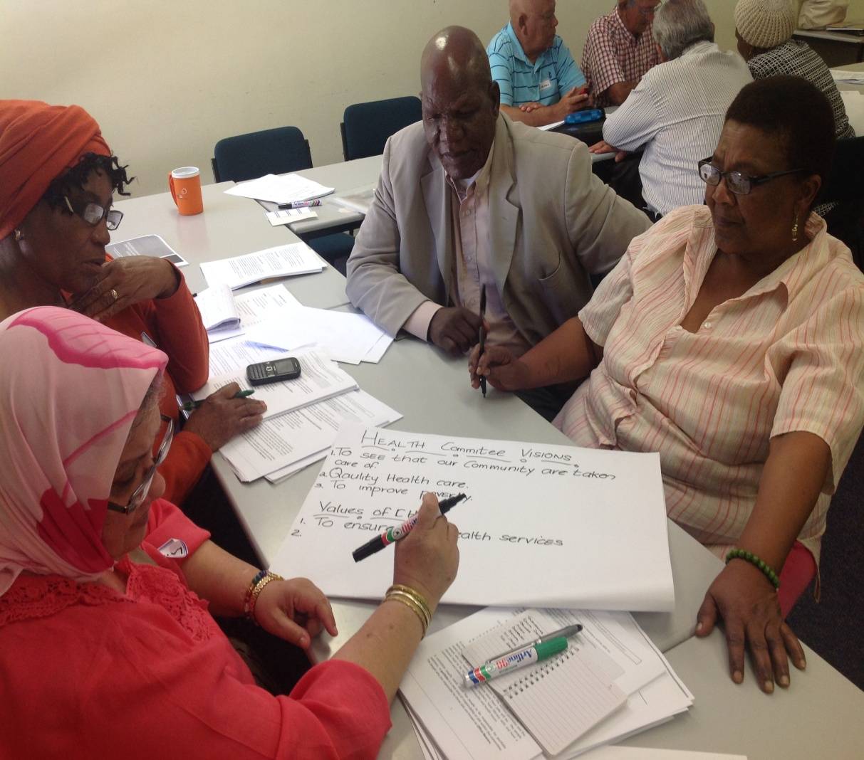
Composition of health committees
Follows NHA | Sector Composition
Mpumalanga, Gauteng, KwaZulu-Natal, Northern Cape Western Cape: Attention to age, gender, race, disability status. | Free State: disability, business, traditional health practitioners, health experts. Eastern Cape: traditional healers, organised labour, community based organisation, religious community, women’s group, youth, NGO, disabled.

Slide 11
Financial support
No support | Reimbursement for expenses | Allowances and Fees
Free State, Eastern Cape, | KwaZulu-Natal Western Cape: MEC may pay transport cost. | Mpumalanga: MEC to determine fees and allowances. Gauteng: fees, allowances for travel and incidental expenses.
Notes:
Research suggest that financial support is crucial.

Slide 12
Support for Health Committees
Type of Support | Province
No Support | KwaZulu-Natal, Free State
Secretariat support | Mpumalanga, Gauteng, Eastern Cape, Western Cape
Office + equipment | Gauteng
Venue | Eastern Cape, Western Cape
Logistical support | Eastern Cape
Training | Western Cape, Eastern Cape, Northern Cape

Slide 13
Policy Environment?

Slide 14
International research
McCoy et al’s (2011): Health committees can contribute to improving health services – not clear how often the case
George et al (2015): Limited evidence of health committees’ effectiveness. 12 % involved in governance. Participation aspects weak.
Molyneux et al (2011). Health committees have the potential to function as accountability structures.
Evidence of HCs potential – limited evidence on how often realised.

Slide 15
South african research
Limited reach (57 % Padarath & Friedman, 2008, 45-60 Haricharan 2012).
Facility manager attendance: contradictory evidence
Limited: input in decision-making and governance
Sustainability issues.
Health committees can improve right to health (Glattstein-Young, 2010
Many barriers – in particular lack of support.
Training of health committees and facility managers can be effective.

Slide 16
Thank You!
More information: www.salearningnetwork.ac.za
Hanne.Haricharan@uct.ac.za

