Slide 1
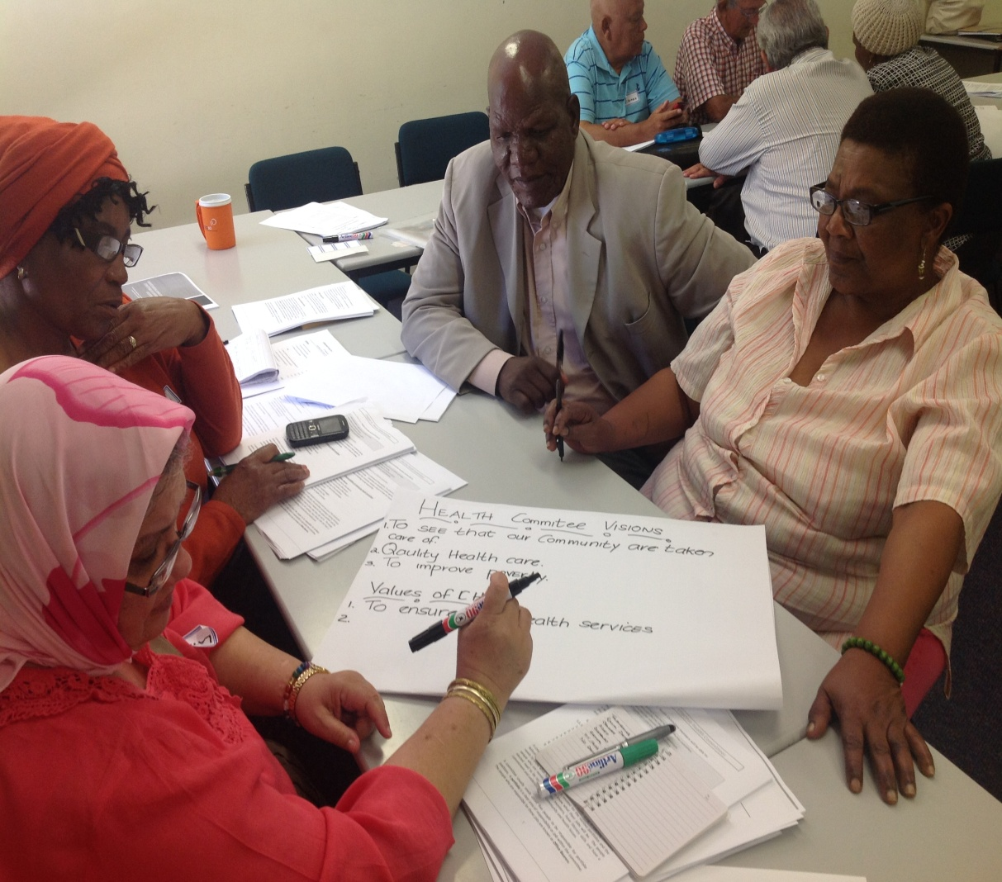
Evaluation of the LN EU project with Health Committees
Hanne Jensen Haricharan, August 2017

Slide 2
What was the EU project?
The programme was part of an EU-funded project titled “Health care users’ experiences as a focus for unlocking opportunity to access quality health services”.
The specific objective for work with health committees was to: “Improve the capacity, authority and mandate of health committees”.
Notes:
Ask how many were part of the EU project?

Slide 3
Background: Research on and work with HCs
Research had identified a number of challenges for HCs: Limited skills, uncertainty about role, participation by facility manager, relationship with facility manager, lack of resources, policy uncertainty, lack of resources.
CMHF/HCs had identified training and capacity building as a way to address these challenges.

Slide 4
What did the EU project do? (related to HCs):
A rapid appraisal of provincial policies on health committees.
Community dialogues.
Training of health committees.
Learning circles and exchange programmes.
HC involvement in complaints management.
Developing guidelines on establishing new health committees.
National colloquium.
Health worker training.

Slide 5
What did the evaluation do?
The evaluation is based on the following data:
A survey with all participants (298) that took part in the training programme was done immediately after the training.
A survey with 58 health committee members (20 percent of all health participants) on completion of the entire project. In-depth interviews with 5 health committee members, 3 members of the Cape Town Metropole.
Field notes.
Assessed overall impact of intervention, but strong focus on the training and capacity component.
Notes:
Mention facility manager – and why not part of it
The questionnaire was self-administered, but conducted in the presence of the projects’ trainers, enabling participants to ask questions when needed.
The questionnaire was self-administered, but conducted in the presence of the researcher, enabling clarification of questions when needed.
The questionnaire was self-administered, but conducted in the presence of the researcher, enabling clarification of questions when needed.

Slide 6
Usefulness of the training
Table 14: Usefulness of training workshops
 | Number | Percentage
Very Useful | 278 | 93.29 %
Useful | 10 | 3.36 %
No Answer | 4 | 1.34 %
Spoilt | 6 | 2.01 %
TOTAL | 298 | 100 %

Slide 7
Confidence in being able to fulfil role as HC member
Category | Number | Percentage
Very confident after the workshop | 273 | 91.61%
More confident, but not sufficiently | 15 | 5.03%
No Answer | 4 | 1.34%
Spoilt | 6 | 2.01%
TOTAL | 298 | 100%

Slide 8
After the training, I understand the role of CHC members
 | Number | Percentage
Yes | 270 | 90.60%
Improved but not 100% clear | 18 | 6.04%
Understood role before training | 3 | 1.01%
No | 1 | 0.34%
Spoilt | 6 | 2.01%
TOTAL | 298 | 100%

Slide 9
Clarity on role:
It gave clarity on what the role of the Health Committee should be in relation to the health facility. You know, I always thought that the Health Committees’ role was to run campaigns; and, you know, do education and awareness. But that was just one aspect of, of what a Health Committee’’ role should be. And the training also focused on how we as Health committees must be involved in looking at the type of services that are delivered at the clinic.

Slide 10
After the training I have a better understanding of the Health System
 | Number | Percentage
Yes | 233 | 78.19%
Improved but more knowledge needed | 55 | 18.46%
No | 4 | 1%
Spoilt | 6 | 2.01%
TOTAL | 298 | 100%

Slide 11
Improved knowledge of Human Rights
 | Number | Percentage
Yes | 252 | 84.56%
More but not enough | 27 | 9.06%
Knew about HR before training | 11 | 3.69%
No | 2 | 0.67%
Spoilt | 6 | 2.01%
TOTAL | 298 | 100%

Slide 12
Improved knowledge of community leadership
 | Number | Percentage
Yes | 264 | 88.59%
More but not 100% | 16 | 5.37%
Knew before the training | 11 | 3.69%
No | 1 | 0.34%
Spoilt | 6 | 2.01%
TOTAL | 298 | 100%

Slide 13
Feeling capable of running an effective Health Committee
 | Number | Percentage
Yes | 255 | 85.57%
Increased but not enough to run a committee | 34 | 11.41%
No | 2 | 0.67%
Capable before workshop | 1 | 0.34%
Spoilt | 6 | 2.01%
TOTAL | 298 | 100%

Slide 14
Confidence in promoting the Right to Health
 | Number | Percentage
Yes | 245 | 82.21%
More but not 100% confident | 44 | 14.77%
No | 3 | 1.01%
Spoilt | 6 | 2.01%
TOTAL | 298 | 100%

Slide 15
Confidence in being a Community Leader
 | Number | Percentage
Yes | 243 | 81.54%
Better but would like to be more confident | 41 | 13.76%
Confident before training | 6 | 2.01%
No | 2 | 0.67%

Slide 16
Improved leadership skills
I think this has made a huge impact on the committee, I’ve seen transformation on leadership. I’ve seen the committees engage at a completely different level. I’ve seen growth in the leadership in the different communities, as well as in the different sub-district. I’ve seen people taking responsibility…. Member of CMHF exco.

Slide 17
HC member confidence in having sufficient skills to function well as HC member
 | Numbers | Percentage
Yes | 52 | 89.65 %
No | 2 | 3.45 %
No answer | 4 | 6.90 %

Slide 18
Increased confidence in working with facility managers
At the beginning it seems as if you’re on two different camps so you engage with them; but you are very cautious. You don’t divulge too much …. I think what has changed is the fact that we do understand more, what they experience and why. The decisions that they implement are not theirs, so we’ve come to that understanding and I do feel that they now realize that we are not actually the enemy on the other side, that we are there to assist them, to communicate their… whatever they have to do to the community and why it’s being done…. So things have changed and I think it’s because of the knowledge that we now have.
Notes:
The new confidence resulted in a different relationship and engagement with facility managers. There were numerous statements regarding improved relationship between facility managers and health committees, based on mutual understanding and developing trust.

Slide 19
Improved relationship with facility managers
I would say out of the 80 %, out of the 90 % that has been trained it has happened [improved relationship with facility managers]: it’s happened in at least 60 % of the clinic committees where health committees have been trained. I’ve also seen that if there’s public engagements; that the facility managers are present … and if it’s not the facility manager that there is a representative that is being sent from that facility. And that is something that has not happened in the past.

Slide 20
Improved relationship with community
We have achieved it (improved relationship with communities) in some communities but not in all the communities, and I think that is work in progress. I think because it’s something that has happened in some communities: but not in most of the communities. And so the committees have a responsibility to ensure that it happens and in some of the committees it happens bimonthly; and in some committees it happens monthly; and in some committees are now adopting it to do it on a quarterly basis, where they have a big public meeting

Slide 21
Stronger voice
They feel empowered and I can tell you, since the Learning Circles, after the meetings we’ve had since our regular executive meetings, they are now more vocal: they will tell you more what’s going on: they will notice things more and they will come and tell you at meetings: this is what is happening.
Notes:
Several respondents highlighted that the project had given people a stronger voice to health committees. In particular, it was argued that less vocal and confident health committee members became more vocal and confident, as illustrated be a member who said that the training had ‘truly empowered health committees’:

Slide 22
Challenging status quo
[The] capacity of health committee [has been important]; and the health committees understanding their role. I think [the programme] has brought about a huge change and a shift of where they have been in just…. Accepting things as it is. Now they are not just accepting things. They want to know why the service is not delivered, and if the services are not delivered what are the reasons. So there has been a complete shift of reasoning in that regard.
Notes:
The CMHF chair-person reflected on how health committees have begun to not accept status quo, but asking question and demanding answers.
Building the

Slide 23
Engaging with health system
And the end result is the fact that this facility has been upgraded…. Extra doctors have been given…. Extra pharmacist has been given, and…. There’s a better understanding and working relation with the local committee.
Notes:
Another example of health committees engaging successfully with departments via the sub-district health forums is rendered by a Cape Metro Health Forum exco-member. When services were closed in one clinic, the committee took the matter to the sub-district level and when that did not yield any result, it was taken to the department.

Slide 24
Constraints remain
The same old problems persist, and that makes it very frustrating for just about anybody who is involved in health committee work….. there is no legislation, there not being resources you know of funds just operating cost for health committee member. So, you know, to travel from home to a meeting and then there’s admin costs; and the cost of the work that they are doing in the clinic, so they are completely un-funded. So that’s the frustration; because now I know what to do, I know how to perhaps contribute to a solution. I have been trained on how to engage with different stakeholder. But I still can’t do anything without resources.
Notes:
rThe same old problems persist, and that makes it very frustrating for just about anybody who is involved in health committee work….. there is no legislation, there not being resources you know of funds just operating cost for health committee member. So, you know, to travel from home to a meeting and then there’s admin costs; and the cost of the work that they are doing in the clinic, so they are completely un-funded. So that’s the frustration; because now I know what to do, I know how to perhaps contribute to a solution. I have been trained on how to engage with different stakeholder. But I still can’t do anything without resources

Slide 25
Challenge of sustainability remains
People again feel abandoned – (it) started out as a very good initiative because I can tell you …. Unless there was a death in somebody’s family; then they didn’t come on a Saturday (for training). That was how committed people were to do the training.

Slide 26
What has changed since 2011/2012?
Indications that HCs are better functioning
Improved facility manager attendance and participation: The 2012 research found that only 44 % of facility manager attended the meeting observed compared to 79 % of HC members indicating that their facility manager attended their last meeting.
Improved relationship with facility manager. The 2012 research indicated that many health committees had a strained relationship with the facility manager. EU evaluation: majority told of good/improved relationships with facility.
Ward councillors’ attendance up from 4 percent in the 2014 survey to 31 %.
Indications of improved relationship with community.
Improved understanding of roles.

Slide 27
Create space for networking and sharing
We could share ideas, we could learn from each other, and I think one of the big ones was the fact that out of this, the voice of health committees has been strengthened and also how they have started working together with each other in the different districts, sub-districts, but also together as a collective at the Metro level.

Slide 28
Conclusion and questions
Improved knowledge.
Improved confidence.
Improved understanding of role.
Improved engagement between HCs, facility managers, ward councillors, health system.
Stronger voice and agency.
Constraints such as funding, resources remain. Legislation promulgated in 2016.
Question: Long term sustainability of gains?
Sustainability of LN and projects?
How do we build on progress?

