Slide 1
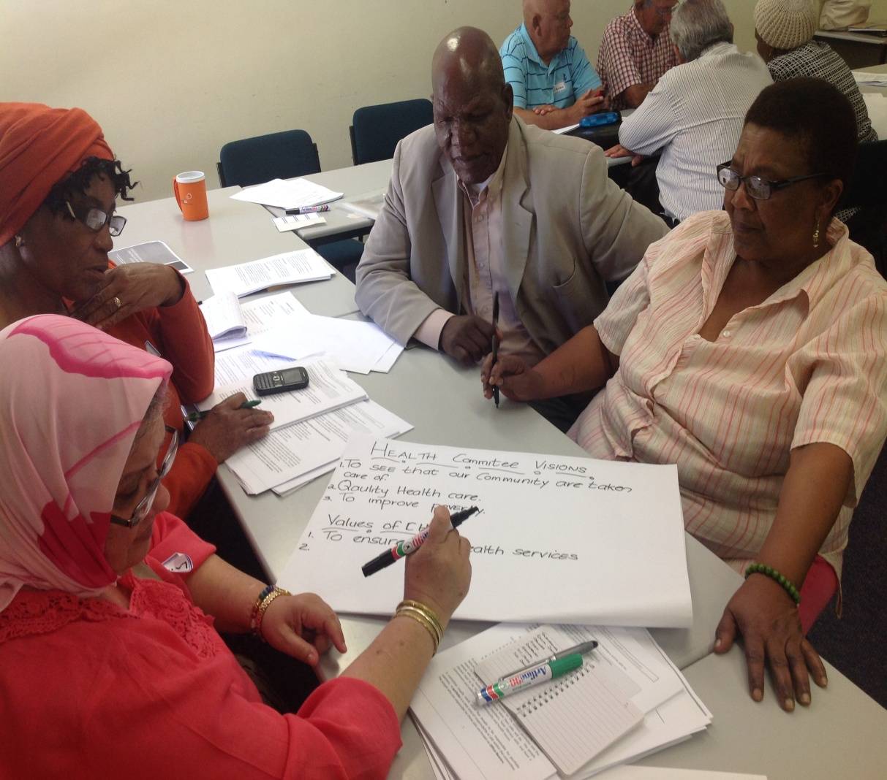
Possibilities and limitations for participation in the invited space: An analysis of the WC Health Committees Act Hanne Jensen Haricharan, October. 2016

Slide 2
The invited space
Gaventa’s three spaces:
Closed: traditional political spaces.
Invited: Spaces where governments invite citizens to participate.
Claimed spaces: Spaces where citizens claim their participation. E.g. mass mobilisation.
The invited space as a ‘new democratic’ space.
Health committees as invited spaces: Participation by citizens in health/governance and primary health care facilities.
Notes:
Talk about how I focus on policy, but speak based on my practical experience. About my Ph.D. research a qualitative mulitiple case study focusing and voice, representation and power in formalised community participation or in the invited space.

Slide 3
Participation in primary health care: the Alma Ata
Participation as a central component to the Right to Health.
Alma Ata (1978): “The people have the right and duty to participate individually and collectively in the planning and implementation of their health care.”
PHC “requires …participation in the planning, organisation, operation and control of primary health care
And develops through appropriate education the ability of communities to participate.”
Notes:
First articulated with the Alma-Ata

Slide 4
A human rights framework for participation: ICESCR and Gen. 14
ICESCR (1996): ‘The right to health’ AND ‘the right to participation’. Recently ratified by SA.
General Comment 14:
Participation = decision-making in setting priorities, planning, implementing and evaluating.
At local, national, global level.
State responsibility to put participatory mechanisms in pace.
The right to health and to participation are both fundamental human rights and central to a PHC approach.
Notes:
Explain what a general comment 14.

Slide 5
SA’s Legislative framework
White Paper on Transformation of the Health System (1997): Participation in planning and provision of health services. Ensure accountability.
National Health Act (2003) provides for establishment of health committees:
a) Each clinic should have a health committee composed of facility manager, ward councillor, community members.
b) Provincial legislation stipulate role and function.
National Draft Policy and Health Governance Structures (2013). HCs: governance structures. Planning and accountability.
Notes:
White paper eccoes Alma Ata, but add s the idea of participation also being about accountability.
The National Health Act give effect to the idea of community particpation by providing a framework for health committees.
Draft policy but the NHI refers to it.

Slide 6
Emerging model of health committee participation:
Rights-based invited spaces.
Governances structures.
Roles in planning, prioriotising, implementation and evaluation, accountability.
Essence of participation: Decision-making power.
But: provinces to give effect to the framework.

Slide 7
Provincial policies on HCs
Province | Policy/legislation exist | Form | Year
Eastern Cape | Yes | Policy | 2009
KwaZulu-Natal | Yes | In Provincial Health Act | 2009
Free State | Yes | In Provincial Health Act | 2009
Mpumalanga | Yes | Guidelines | 2009
Gauteng | Yes | Draft guidelines | 2009
Western Cape | Yes | Act | 2016
Limpopo | ? |  | 2009
NorthWest | Yes |  | 2014
Northern Cape | Yes | Policy | 2013
Notes:
SA has nine provinces – 7 have policies, limited knowledge about implementation

Slide 8
HC policy process in WC
Draft policy 2008
Decision not to implement draft policy, but rather amend the Health Facility Boards Act.
Consultation process with communities and health committees (DHC and the LN).
Key issues raised:
1)Health committees to be elected rather than appointed.
2) Role of health committees: governance, accountability
3) Support and funding for health committees,
2015 Health Committee Bill.
Policy submissions, presentations and contestation.
2016 Act passed with minimal changes.
Process with minimal ‘participation’.

Slide 9
Roles of WC Health Committees
Duties (HC must undertake)
Request feedback on measure taken to improve quality of services.
Assist community to effectively communicate needs, concerns and complaints
Foster community support
Encourage volunteers
Conduct scheduled visits in cooperation with management
Provide constructive feedback to enhance service delivery

Slide 10
Powers of WC health committees
Powers: HCs (roles HCs may take on)
Advise and make recommendations to the MEC, management on performance.
Advise and make recommendations to MEC on renaming
Obtain information
Request copies of routine progress reports
Conduct surveys meetings and workshops in the communities
Dissiminate information…..
Conduct fundraising activities – to be administered by the Board

Slide 11
Roles
MEC can expand roles and revoke them depending on perceived capacity of committees.
No role in governance or accountability.
Limited decision-making power.
Not rights-based: Note language: ‘request’, ‘advise’.
MECs power.

Slide 12
Representation in HCs
Objects of Act: Establish representative and accountable boards and committees.
MEC appoints committees based on nomination.
Nominations from ‘a body that in the opinion of the MEC is sufficiently representative of the community’.
May delegate to HoD or other employees.
Minimum 50 % community representatives.
‘Sensitivity’ to race, gender, age, disability.
NB: MEC appoints in 7 out of 9 provinces.

Slide 13
Linkages to other structures
MEC must put in place measures for collaboration between:
Boards, committees and district health councils.
Board/Committee and head of facility.

Slide 14
Support
Venue.
Secretarial, administrative and financial accounting support.
Induction and training.
MEC may pay transport reimbursements.

Slide 15
Comparison of roles of health committees in SA provinces
Role | Explanation | Provinces
GOVERNANCE | Policy, strategy, planning, identify health needs, advice | All besides WC?
GOVERNANCE, Oversight, accountability | Monitoring/evaluation, complaints management | All besides WC
Notes:
Policies vary greatly in length, content and detail. Only one provincial policy talk about hc’s as governance structure: Northern Cape.

Slide 16
Comparison between Facility Boards and HCs
Facility Boards | Health Committees
Participate in strategic planning (advisory role)
Monitor performance, effectiveness and efficiency + measures taken to improve these. | Request feedback on measure taken to improve quality of services.
Take measures to ensure that the needs concerns and complaints are addressed. | Assist community to effectively communicate needs, concerns and complaints
Raise and manage fund | Raise fund

Slide 17
Comparison to 2008 Draft policy
Roles 2008 Draft Policy
Provide governance as it relates to service provision
Take steps to ensure that the needs, concerns and complaints of patients and the community are properly addressed by the management.
Foster community support for the initiatives and programmes of the facility
Monitor the performance, effectiveness and efficiency of the facility.
Three important changes:
Shift away from roles in governance/accountability
No tiered structure
HC to be appointment rather than elected.
Notes:
Much stronger roles – resembles those of Facility Boards

Slide 18
Comparison with HR framework
HR framework
Role: planning, priority setting, implementation, accountability
Participation as decision-making
Local, national, global level
WC Act
No roles in governance or accountability
Unclear what decision-making power they have.
Localised structures with limited linkages.
Notes:
Policy check my proposal

Slide 19
Possibilities and limitations in the WC Act
Limitations;
Limited roles
MEC’s power, in particular re. appointment and roles
Questions of representivity and legitimacy
Limited linkages to other structures
No funding
Possibilities:
HCs are statutory bodies.
HCs have a mandate
Community member majority
Training obligation
Obligation to provide support
Collaboration

Slide 20
Expanding the invited space?
The invited space risks becoming an ‘ambiguous space‘ with top-down and limited participation; MEC is in control; representation not founded on democratic principles.
Implementation unknown. Expansion possible, but dependent on MEC.
The HR argument: inconsistent with an HR framework.
Pressure from ‘spaces’ outside the invited space?
Collective action and collaboration? Addressing the problem of atomized HCs.

Slide 21
Thank you
Funding and support for my Ph.D. research from the Wellcome Trust and the SASH fellowship is greatly appreciated.
More information: salearningnetwork@uct.ac.za
Hanne.Haricharan@uct.ac.za

