Slide 1
What Does the Right to Health Mean from a Human Rights Perspective?
SAHRC Meeting on Access to Health Care, Vredenburg

Slide 2
Learning Network Mission
Mission
The Learning Network strives to build best practice in realising the right to health through action and reflection

Slide 3









Notes:
You might want to distinguish funders from members

Slide 4
What do you need to survive?

Slide 5
Needs and Rights
Needs Rights
Human rights address fundamental needs (a need for food, water, housing, freedom, assistance)

Slide 6
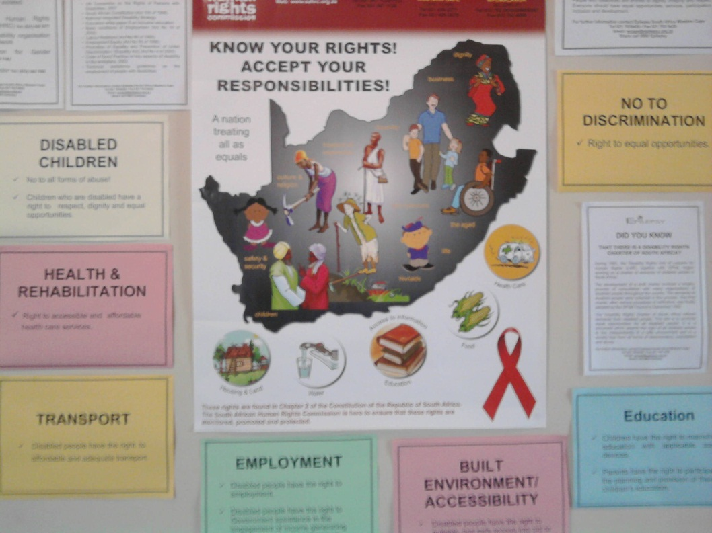
Definitions of rights
Basic standards needed to live in dignity
Moral
principles
that apply to
everyone

Slide 7
Health and human rights
A lack of human rights can affect health
Health problems can cause discrimination
Health problems make it difficult to access other rights
Health policies and programmes
can deny rights

Slide 8
What is the right to health?
Is not the right to be healthy
Is the right to access to health care
And the right to conditions needed for health (water, sanitation, food, housing, environment)
Notes:
Besides the social determinants, it is also about equality, respect, dignity, etc, I would make that clearer

Slide 9
Universal Declaration of Human Rights
Article 25
Everyone has the right to a standard of living adequate for the health and well being of himself and his family, including food, clothing, housing and medical care and necessary social services…

Slide 10
International Covenant on Economic, Social and Cultural Rights (ICESCR)
Article 12
The right of everyone to the enjoyment of the highest attainable standard of physical and mental health

Slide 11
What general rights are related to the right to health?

Slide 12
Rights related to health
The rights to life, dignity and equality
The right to bodily and psychological integrity
The right to a healthy environment
The right to food and water
The right to housing
The right to access to information

Slide 13
Patient Rights Charter
Right to access to health care
Right to confidentiality and privacy
The right to a healthy and safe environment
The right to be communicated with in a language you understand
The right to be treated by a named provider
The right to refuse treatment / ask for a second opinion
The right to complain
The right to informed consent
The right to participate in health care decision making
The right to information about health/costs
The right to continuity of care
Notes:
The PRC is a list of things, some of which are ‘rights’ in the sense of claims in terms of the Bill of Rights, and others, which are derived entitlements, which could be rights, but may not be. For example, the right to continuity of care is important but I am not sure it is always a right. If the state can provide you with good quality care from different providers, that meets all the General Comment elements, then I don’t think it is violating rights if you don’t get the same provider. Similarly, the right to be treated by a named provider, is a matter of dignity and respect. The right is to dignity and respect and one of many ways that happens is when the provider gives you their name. They may not need to wear a nametag to do that.
So, I would rather treat the PRC as a quality assurance standard.

Slide 14
What does the right to “access to health care” really mean?

Slide 15
Access to Health Care
Availability
Accessibility
Acceptability
Quality

Slide 16
Availability
Functioning facilities and services
Access to underlying determinants of health (water, sanitation)
Medical care for emergencies
Trained personnel
WHO essential drugs

Slide 17
Accessibility
Existence of services in communities
Services accessible without discrimination
Health care is distributed equitably
Services are physically accessible
Services are affordable
Information is accessible

Slide 18
Acceptability
Services are sensitive/responsive to patient needs, fostering culture of dignity
Facilities respect medical ethics
Services are culturally appropriate
Translation should be available
Sensitive to gender and age
Respectful of confidentiality/privacy

Slide 19
Quality
Services are medically appropriate
Standards for treatment and quality
Meets health needs
Well-trained and -supervised personnel
Scientifically approved, unexpired drugs
Quality buildings, adequate water, sanitation

Slide 20
How can the right to “access to health care” be ensured?

Slide 21
Obligations & Health Rights
What government (and others) must do:
Respect (no interference in exercise)
Protect (prevent violations of rights)
Fulfil (positive action to ensure rights)
Promote (ensure rights are known)
Notes:
“Promote” is a ‘uniquely’ South African feature of human rights – that’s why the SAHRC has the job it does, and why it is holding this hearing/meeting?

Slide 22
Obligations & Health Rights
How does government have to secure health rights:
Progressive Realisation
Participation
Accountability

